Slide 1


Operating Systems:
Introduction
Fabrice BOISSIER<fabrice.boissier@epita.fr>
Bachelor’s Special Edition
2021-01-14

Slide 2
References
Modern Operating Systems [en/fr] Andrew S. Tanenbaum, Herbert Bos
Linux – Programmation système et réseau [fr] Joëlle Delacroix
Advanced Programming in the UNIX Environment [en] UNIX Network Programming, Volume 1: The Sockets Networking API UNIX Network Programming, Volume 2: Interprocess Communications W. Richard Stevens
Operating Systems Concepts [en] Abraham Silberschatz, Peter Baer Galvin, Greg Gagne

Slide 3
Outline
Basic architecture concepts required
Hardware
What is an OS
Why and where do we need OS
History of computing
What is inside an OS
Kernel/Services/Applications
Main concepts
UNIX & Linux

Slide 4
Basic architecture concepts required
CPU: central processing unit
Register: variable of the CPU
Device: hardware
Interruption: way to handle an event for the CPU
Hardware interrupt or IRQ: Interruption from hardware
Software interrupt: Interruption from software

Slide 5
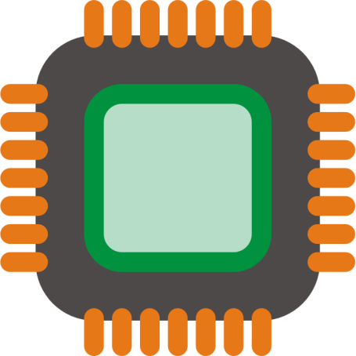
CPU

Slide 6
Registers
CPU

Slide 7
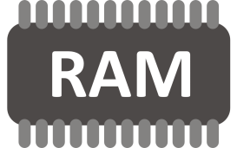
BUS
Registers
CPU
Memory

Slide 8
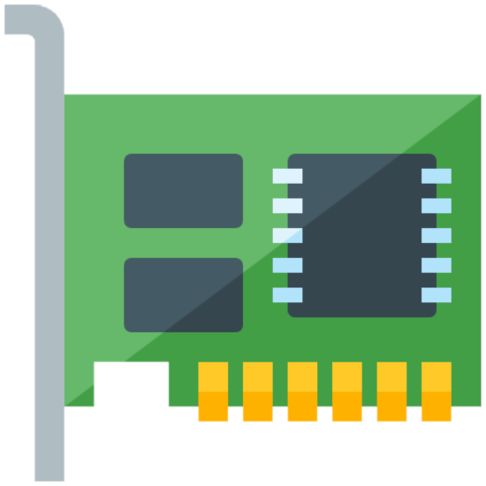

BUS
BUS
Registers
Devices
CPU
Memory

Slide 9
BUS
BUS
Registers
Devices
CPU
Memory
IRQ

Slide 10
BUS
BUS
BUS
Registers
Devices
CPU
Memory
BUS
IRQ

Slide 11
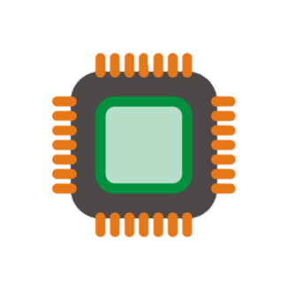
BUS
BUS
BUS
Registers
Devices
CPU
Memory
BUS
IRQ

Slide 12
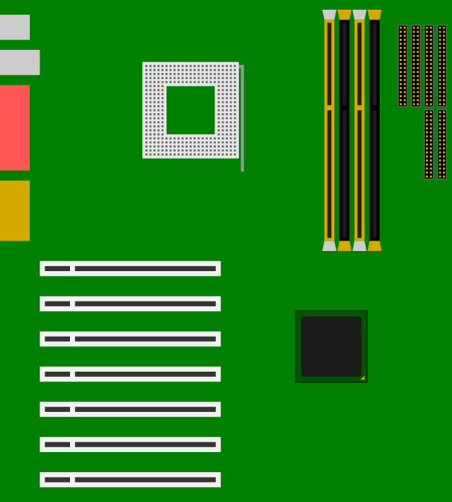
Basic architecture concepts required
The motherboard offers services to the CPU:
Interruptions / IRQ mouse, keyboard, … send IRQ and data
Memory / DMA copy this range of memory to that address
FSB (Front Side Bus) synchronization of all physical components
…but also limitations:
Max number of CPU
Max physical memory
Everybody is linked to the FSB

Slide 13
Basic architecture concepts required
Memory: huge array of cells containing data
0x0000
0xFFFF

Slide 14
Basic architecture concepts required
Memory: huge array of cells containing data
0x0000
0x0001
0xFFFB
0xFFFC
0xFFFD
0xFFFE
0xFFFF

Slide 15
Basic architecture concepts required
Memory: huge array of cells containing data
char *str = 0xFFFB;
str[0] = ‘A’; // 0xFFFB
str[1] = ‘T’; // 0xFFFC
str[2] = ‘I’; // 0xFFFD
…
int *nb = 0x0001;
(*nb) == 42
42
‘A’
‘T’
‘I’
‘P’
‘E’
0x0000
0x0001
0xFFFB
0xFFFC
0xFFFD
0xFFFE
0xFFFF

Slide 16
Basic architecture concepts required
Memory: huge array of cells containing data
e.g.: 64 kB
42
‘A’
‘T’
‘I’
‘P’
‘E’
0x0000
0xFFFF

Slide 17
Basic architecture concepts required
Memory: huge array of cells containing data
Each cell stores a specific size of data
42
‘A’
‘T’
‘I’
‘P’
‘E’
0x0000
0xFFFF

Slide 18
Basic architecture concepts required
Memory: huge array of cells containing data
Each cell stores a specific size of data
Stack: specific part of memory that pushes/pulls data
Usually at the end of the memory, growing up toward beginning
42
‘A’
‘T’
‘I’
‘P’
‘E’
0x0000
0xFFFF

Slide 19
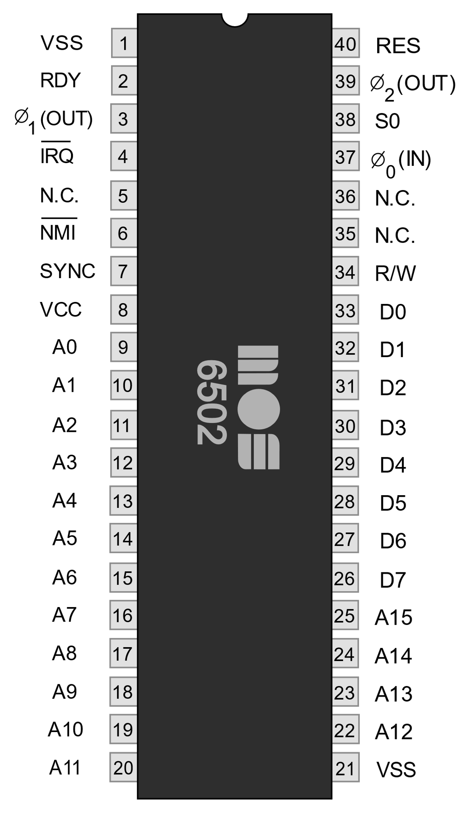
CPUs have 3 main buses
Data Bus
For transfering data
Address Bus
For selecting address
Control Bus
For communicating with devices

Slide 20
Control Bus
Data Bus
Address Bus

Slide 21
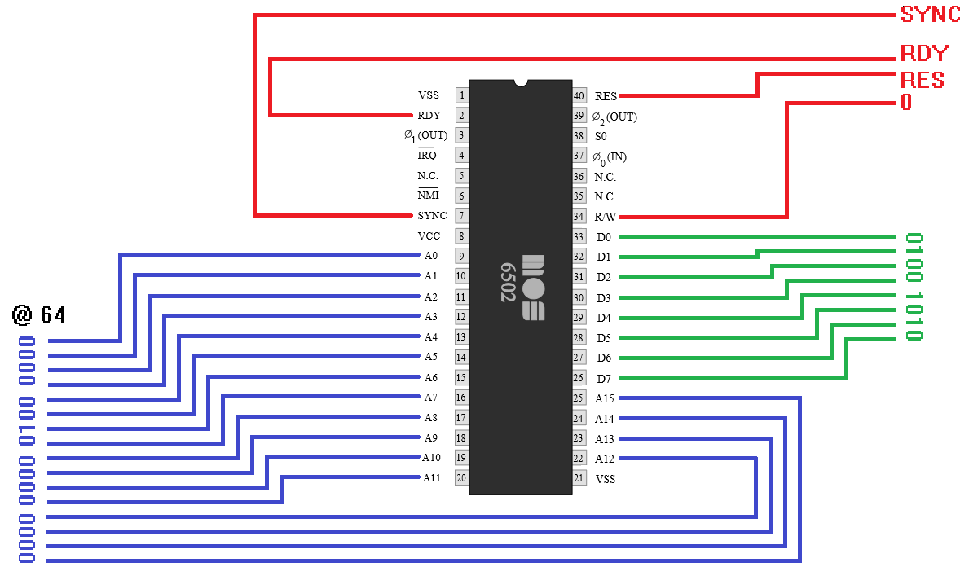
Example:
Write ‘J’ at physical address 64
READ = 1
WRITE = 0
‘J’ in ASCII:
4 A
0100 1010
Notes:
On data bus: the CPU puts the data to write ‘J’ (in binary)
On address bus: the CPU puts the address where to write the data (64 in binary)
On the control bus:
- On the R/W pin: the CPU puts 0 to say it will write into the memory chips
- Other pins are used to synchronize and say when the data is ready => absolutely not important in this introductory course

Slide 22
Basic architecture concepts required
Protection rings:
Model of protection
Levels/Layers of autorisations
Each level has specific permissions
Intel example: 4 levels
ring 0 = most privileged mode
…
ring 3 = least privileged mode (regular mode)

Slide 23
Basic architecture concepts required
Ring 3 - User mode:
Context in which the CPU allows the minimum actions
Regular memory addresses can be accessed
(areas not reserved for the system or specific management)
Regular instructions can be executed
(move, arithmetic, logic, branch, …)

Slide 24
Basic architecture concepts required
Ring 0 - Supervisor mode - Privileged mode:
Context in which the CPU allows more actions
Allows access to restricted memory addresses
(you might not want that another program erases your mallocs…)
Allows execution of restricted instructions
(you might not want a HALT to happen anytime…)
…

Slide 25
What is an Operating System?

Slide 26
Operating systems perform two essentially unrelated functions: providing application programmers (and application programs, naturally) a clean abstract set of resources instead of the messy hardware ones and managing these hardware resources.
-- Tanenbaum & al.
An operating system is software that manages a computer's hardware. It also provides a basis for application programs and acts as an intermediary between the computer user and the computer hardware.
-- Silberschatz & al.

Slide 27
Operating System: Another definition
User
OS
Machine
Usable Interface
Resource Management
Hardware Independence

Slide 28
Operating System: Another definition​
Most used definition:
Resource allocation
Resource management
Other:
Second software layer on bare hardware
Firmwares on 1st layer (BIOS, UEFI, SoC, embedded, …)
Kernel + Utilities above the machine

Slide 29
Operating System: Another definition​
Applications
Environment
Command Line / Shell
System Utilities
Distribution
Operating System
Syscalls
Kernel
System Services
Hardware

Slide 30
Where do we need an Operating System?
Computer
Mobile Phone
VOIP Phone
Sim cards
Printer
Car
...

Slide 31
History
Generations
Taxonomy of machines and OS
http://www.computerhistory.org/timeline/computers/

Slide 32
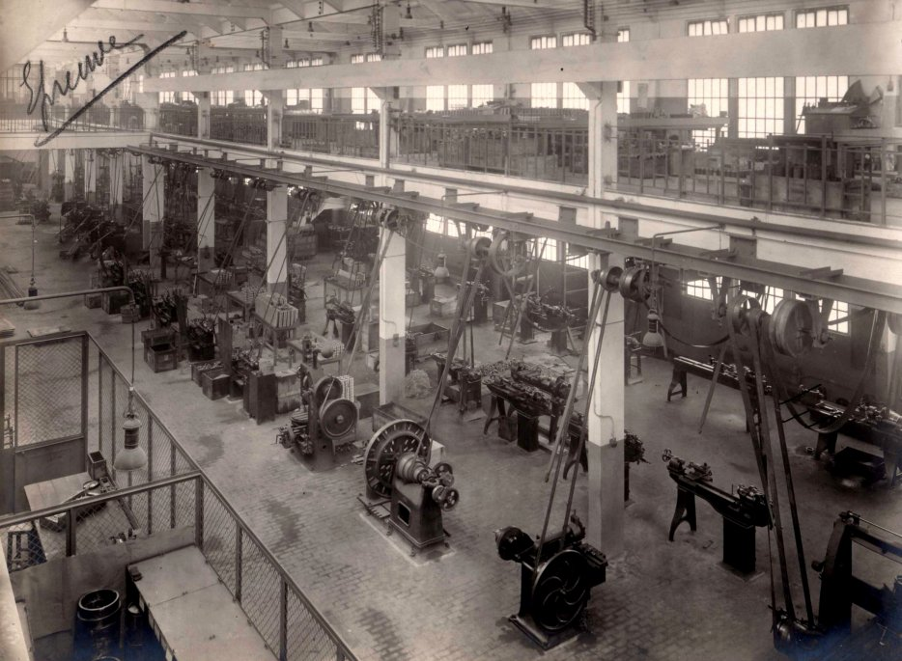
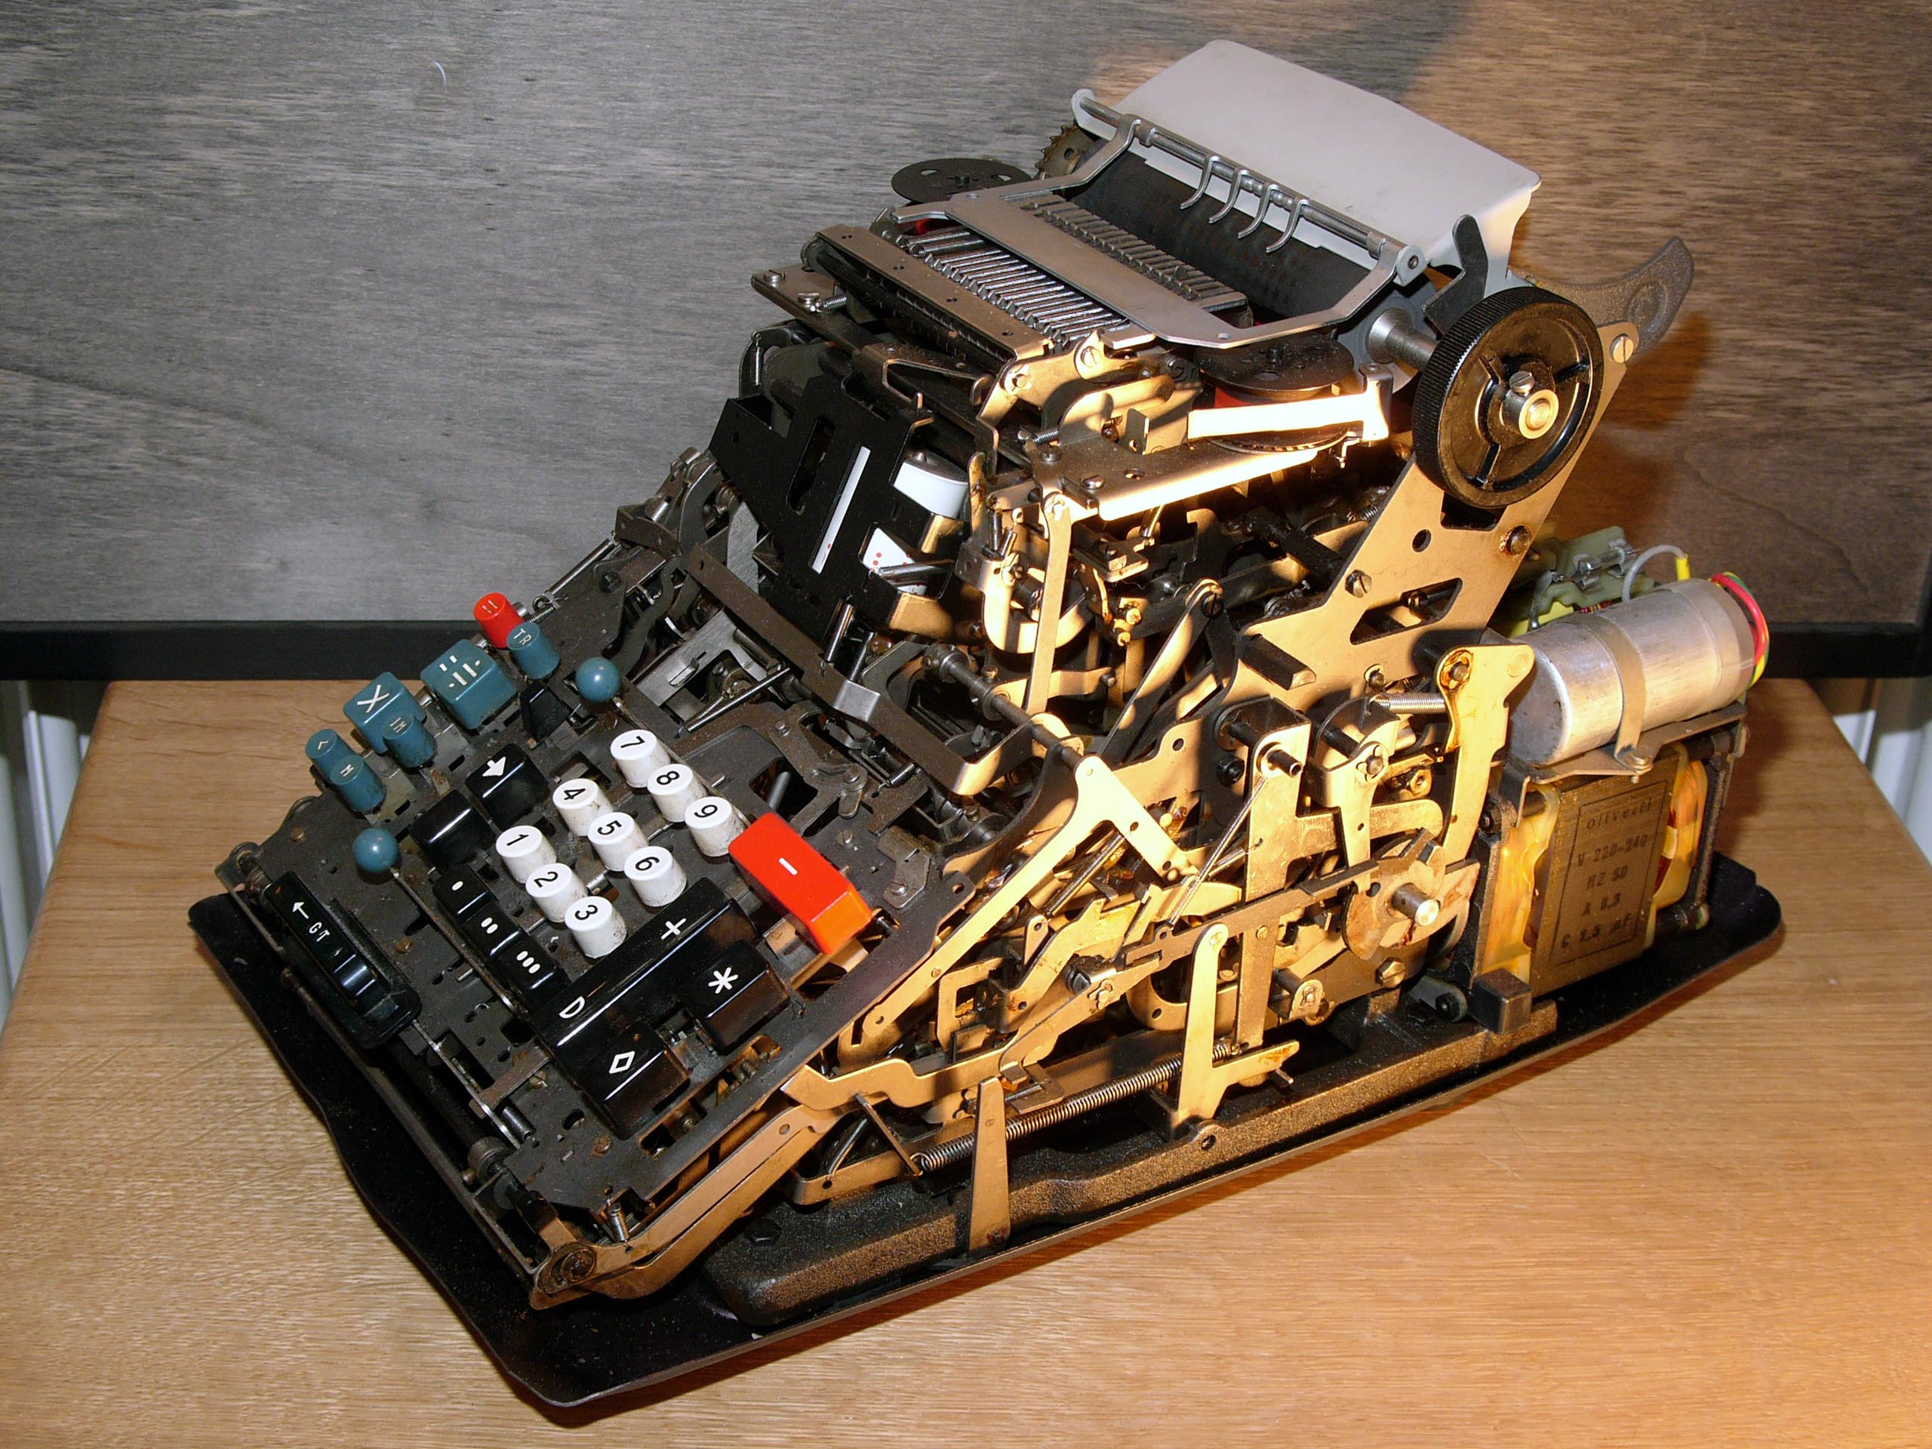
Before/Without computers: Machines
Manual tasks
Mechanical (gears, timing belts, …)
Electromechanical
(Watch « Monsieur Patron » clip: everything is already here during the 50’s-60’s, but in mechanical version…)
Don’t forget: Initially, IT resolved business problems
Notes:
Picture on the right: rooms were filled with belts to transfer « energy » (like electricity nowadays… and network)
However, loom (métier à tisser) were already possible to code with a punch card (carte perforée)
Usages: Production, management, …
Business Problems: verify calculus, speed of production/calculus, increase quantity/speed of production, speed of communication, …

Slide 33
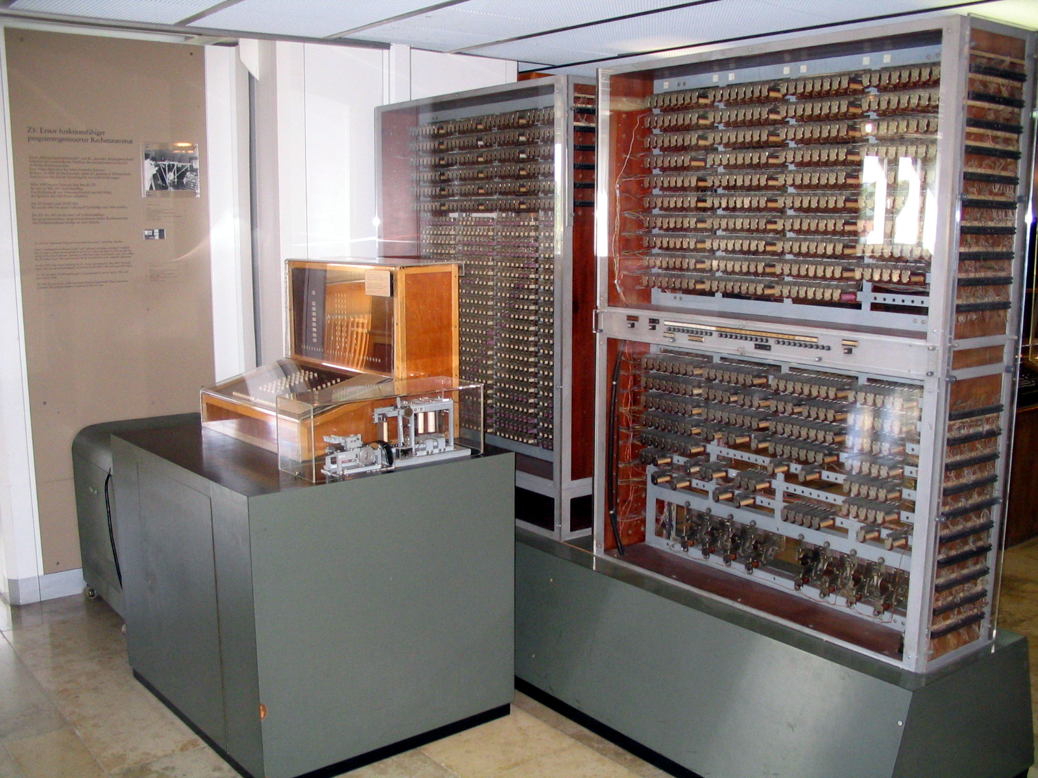

First Generation (1945-55)
You « code » your program directly by linking/unlinking boxes each of which executes a single function (full of electric relays + ferrite toroid memory)
Notes:
Left: Z3 (Zuse) Right: ENIAC [« Relais électriques » & « Mémoire à tore de ferrite »]
ENIAC: Plugboards contain one function (add, substract, …) and are linked together.
Usages: Military calculus, Scientific calculus, and a bit of management

Slide 34
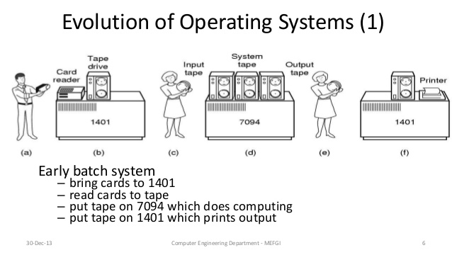
Second Generation (1955-65)
Notes:
Each furniture does a complete processing: process data (add, sub, mul, loop, …), read input, print output, read/write on magnetic tape.
Lot of external furnitures and processing (machine for making holes in punch card, human doing the holes based on a writing program, …).

Slide 35
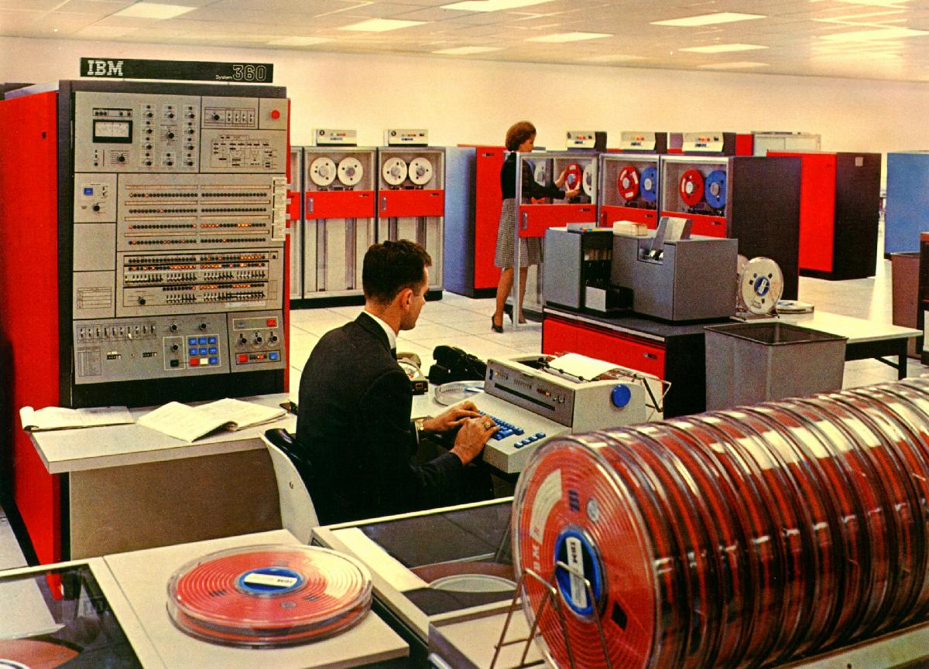
Second Generation (1955-65)
Notes:
Each furniture does a complete processing: process data (add, sub, mul, loop, …), read input, print output, read/write on magnetic tape.
Lot of external furnitures and processing (machine for making holes in punch card, human doing the holes based on a writing program, …).

Slide 36
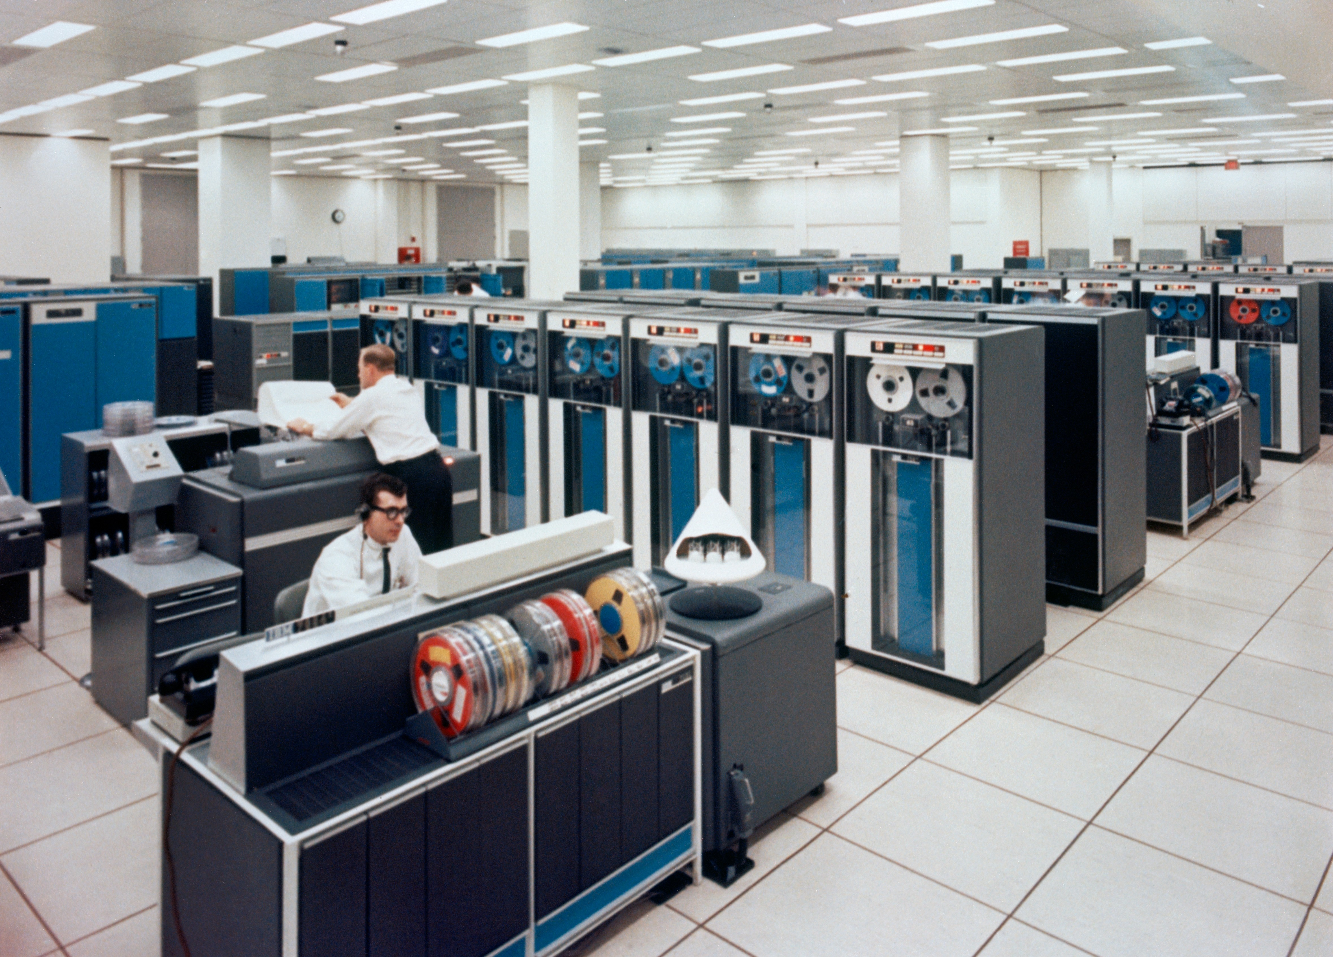
Second Generation (1955-65)
Notes:
Each furniture does a complete processing: process data (add, sub, mul, loop, …), read input, print output, read/write on magnetic tape.
Lot of external furnitures and processing (machine for making holes in punch card, human doing the holes based on a writing program, …).

Slide 37
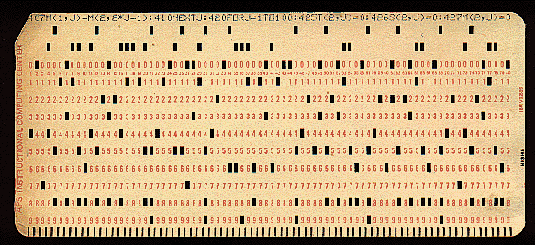
Second Generation (1955-65)
Punch card contains the « code », and eventually the « data » (and mainly the launcher/script)
(E)BCDIC: character encoding
Notes:
Launcher/Script : JCL (Job Control Language)
Punch card: you can touch and read your data directly!

Slide 38
Second Generation (1955-65)
Machines: Mainframes
Each « huge » machine has a precise role: Calculate, read punch card, print results, store on magnetic tape
IBM example:
Machine: System 360 (later: S/370, S/380, S/390, zArch)
OS: OS/360 (later: OS/370, MVS, z/OS)
Programs compiled for OS/360 are still compatible nowadays
Other: Burroughs (B5000), General Electrics (GE-635), …

Slide 39
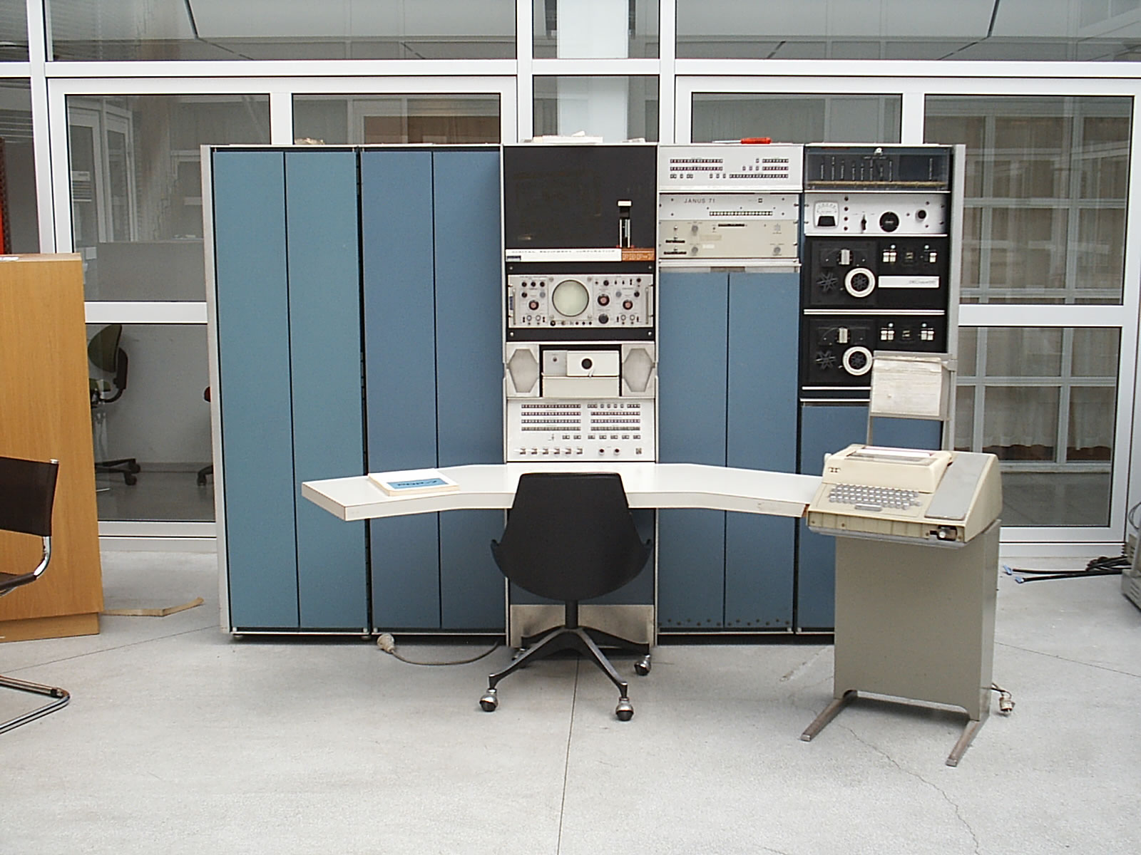
Third Generation (1965-1980)
Notes:
Multiprogramming
Beginning of the Unixes
Timesharing

Slide 40
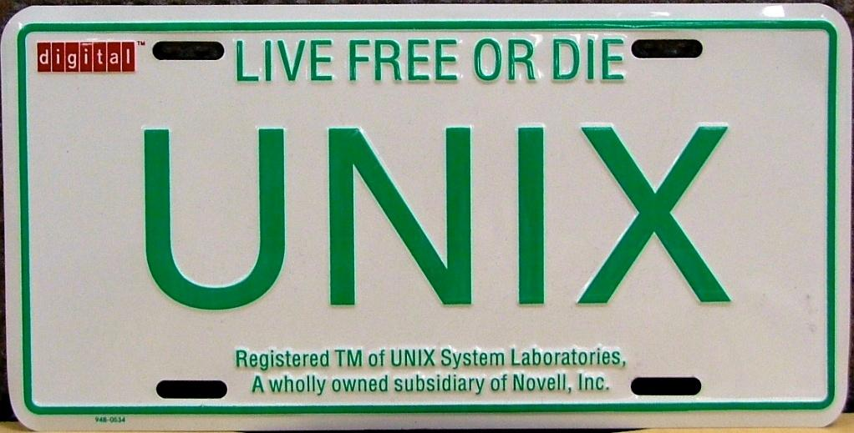
Third Generation (1965-1980)
Notes:
Multiprogramming
Beginning of the Unixes
Timesharing

Slide 41
Third Generation (1965-1980)
Machines: Minis (future « servers »)
Smaller furnitures than mainframes
Affordable for middle and somewhat small companies
Beginning of the « invasion » of computers in the companies
Examples: DEC (VAX & PDP), CII (Mitra 15), Télémécanique (SOLAR 16), HP (HP-3000), …
OS: a lot… VMS, and obviously UNIX
Notes:
« mini », because they are smaller than a « mainframe »
« server », because a terminal/client (that is dumb/have small CPU and few memory) makes queries to a server (which has bigger CPU and more memory)

Slide 42
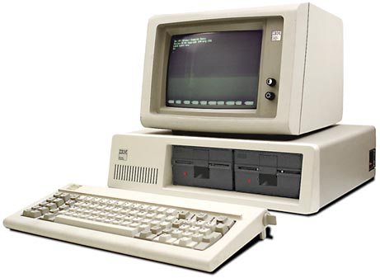
Fourth Generation (1980 - …)

Slide 43
Fourth Generation (1980 - …)
Machines: Personal Computer
Very small machines affordable by consumers
Very simple at the beginning
Everybody (rich enough) can own a computer
Examples:
zx80, VIC-20, Atari ST, …
…and obviously the IBM 5150 / IBM PC
Tons of OS… + some UNIX, CP/M, Macintosh, MS-DOS

Slide 44
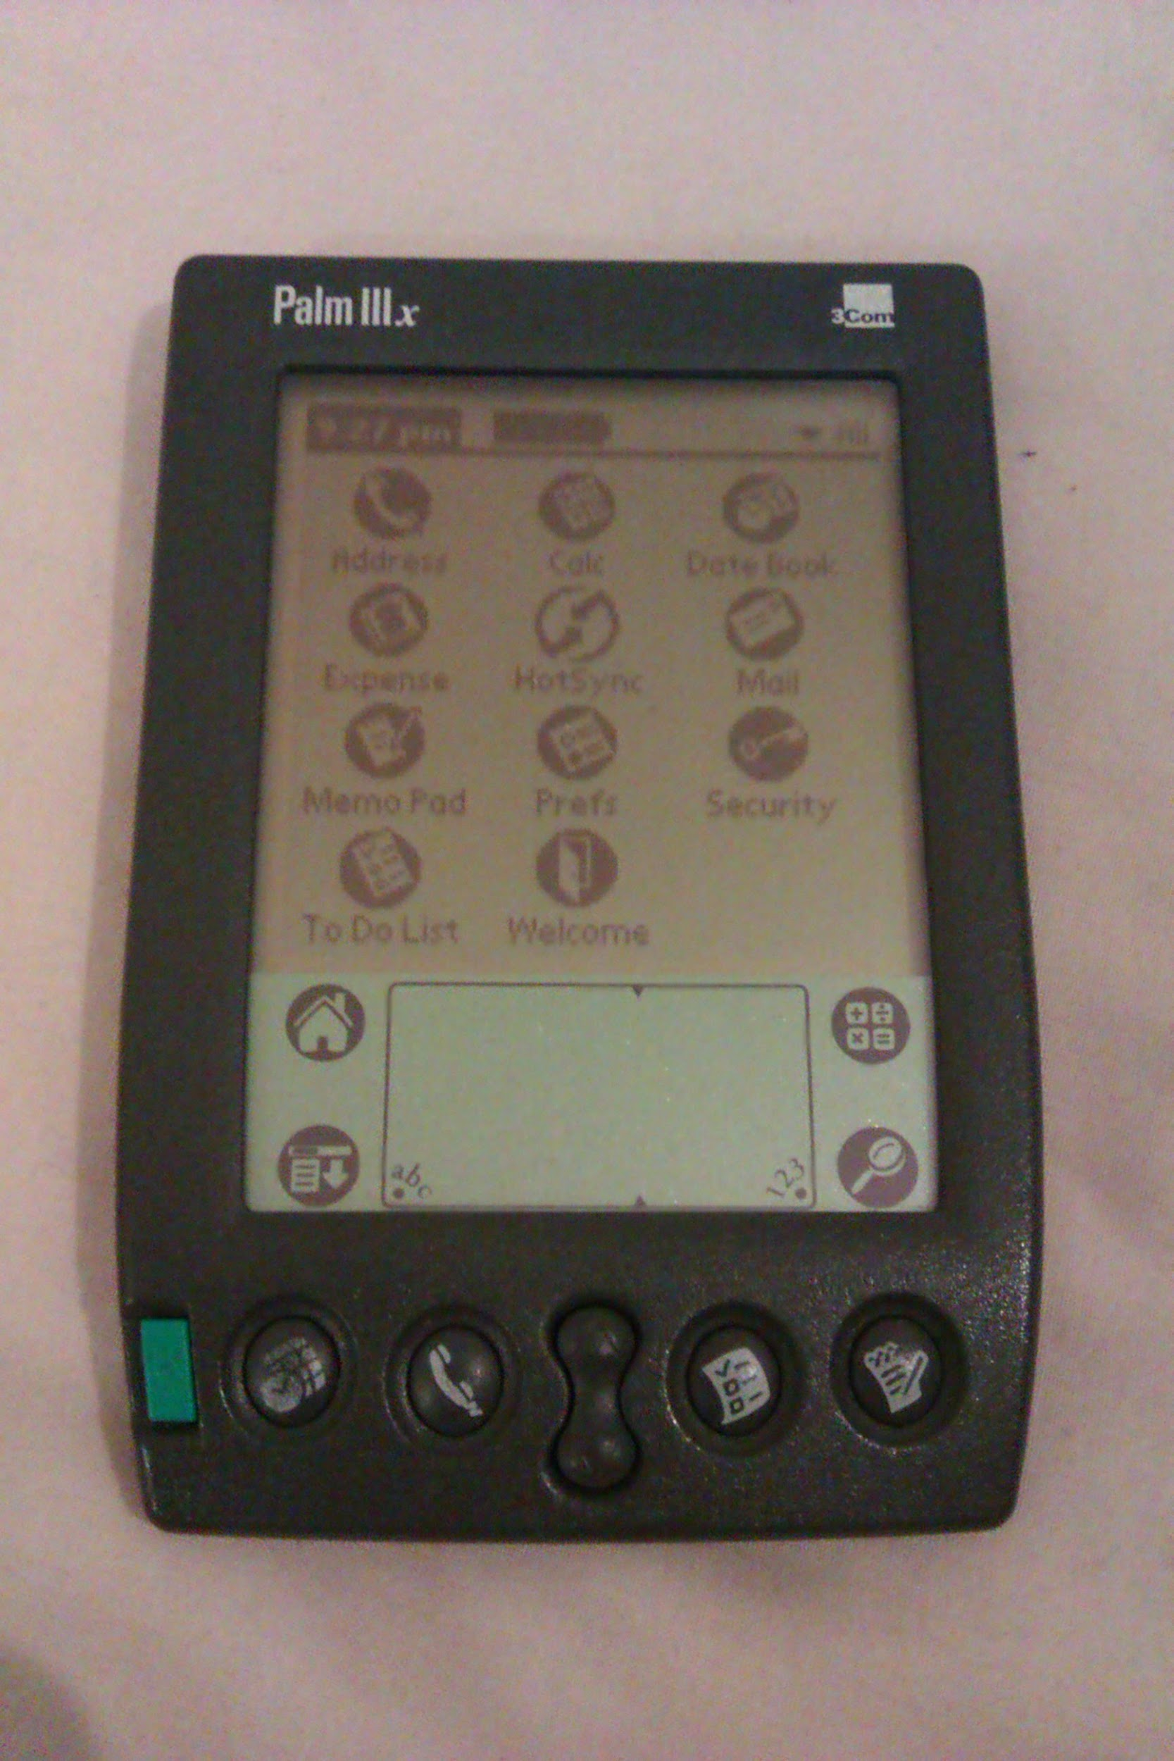
Fourth or fifth generation?...
Notes:
Miniaturization.

Slide 45
OS taxonomy?
It is difficult to split an operating system into a single category. Historically, each specific task has a specific operating system tailored for it. Now the barriers between the different workloads are blurred.
Each company tried its own concept. If a company succeeded, everybody copied it.

Slide 46
History: OS for a specific workload
Mainframe
Mini/Server
Multiprocessor
Personal Computer
Embedded (and Mobile)
Real-Time (Soft or Hard)
Smart Card

Slide 47
History: Why that much differences?
Computing power was limited
For each workload a different way to handles tasks
Single-Task, Single-User
Multi-Task, Single-User
Multi-Task, Multi-User
More computing power, more complexity forces OS designers and vendor to simplify and reuse more components
Notes:
Linux is everywhere, you can’t get away with it.
Reusing an operating system (like any software or part) is good for business :
you just have to adapt it for your architecture
simpler to find people qualifed to work on it
less maintainance costs

Slide 48
History: What is the actual status
General purpose Operating Systems:
Desktop (MS Windows, macOS, Linux, Chrome OS)
Server (Linux, MS Windows Server, few UNIX)
Mainframe (z/OS, zLinux, GCOS)
Multiprocessor (most of the general processors we find are now multi-core at least)
Embedded (Linux or specific OS on multiple kind of devices, cars, cameras, printers… Android or iOS for mobile and smartphones)
Real Time Operating Systems
Hard Real-Time
Soft Real-Time

Slide 49
Desktop
Application driven
Multimedia
Screen
Graphic acceleration
Input devices (keyboard, mouses, …)
Multiple kind of devices hooked on it
Interaction with the user
Windows, macOS, Linux (tons of distributions…)

Slide 50
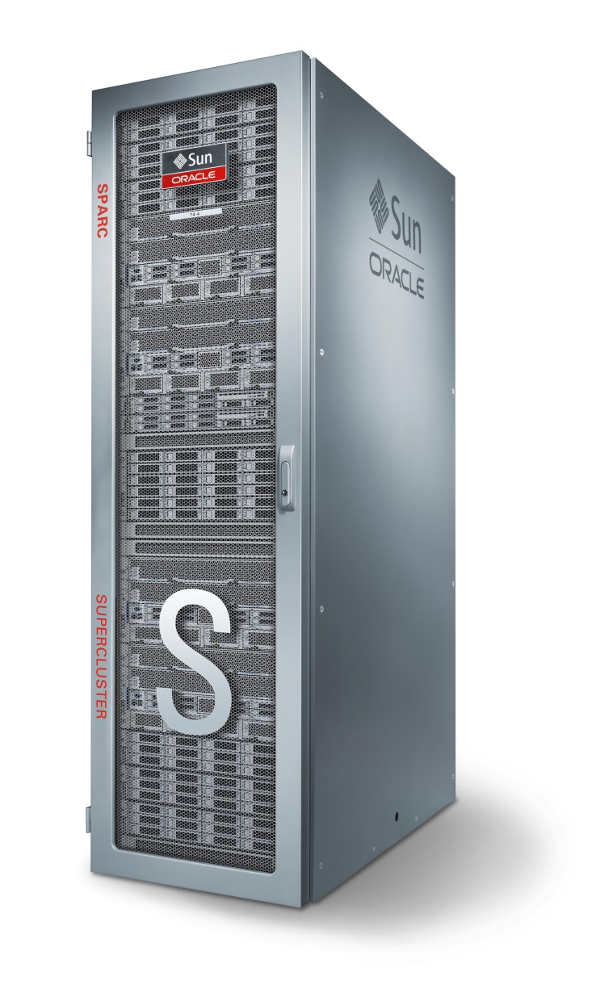
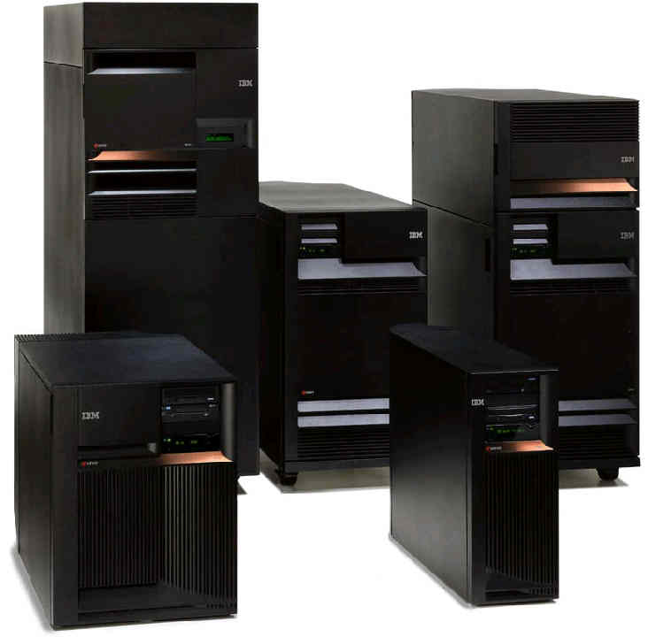
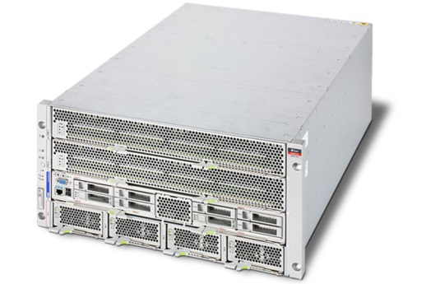
Server
Notes:
Usually is a unit in a rack (the famous « U » : 1U, 2U, 4U, …), might be a full rack, or in a workstation format

Slide 51
Server Operating Systems
UNIX-like & Linux
Certification for being « UNIX compliant »
Available on nearly « every » CPU architecture possible
Linux is not a UNIX… it is a project recode from scratch
Windows Server
Very user friendly thanks to a graphical user interface (GUI)
Has a full console version since 2010~2012
IBM i (formerly known as OS/400)
Runs on « IBM i » machines (previously known as AS/400)
Absolute abstraction with the hardware

Slide 52
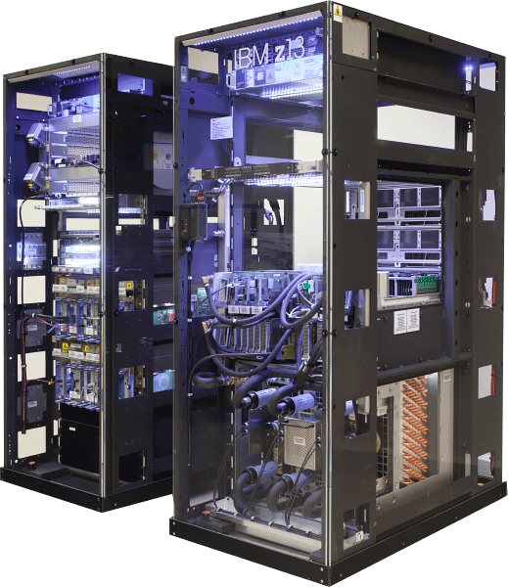
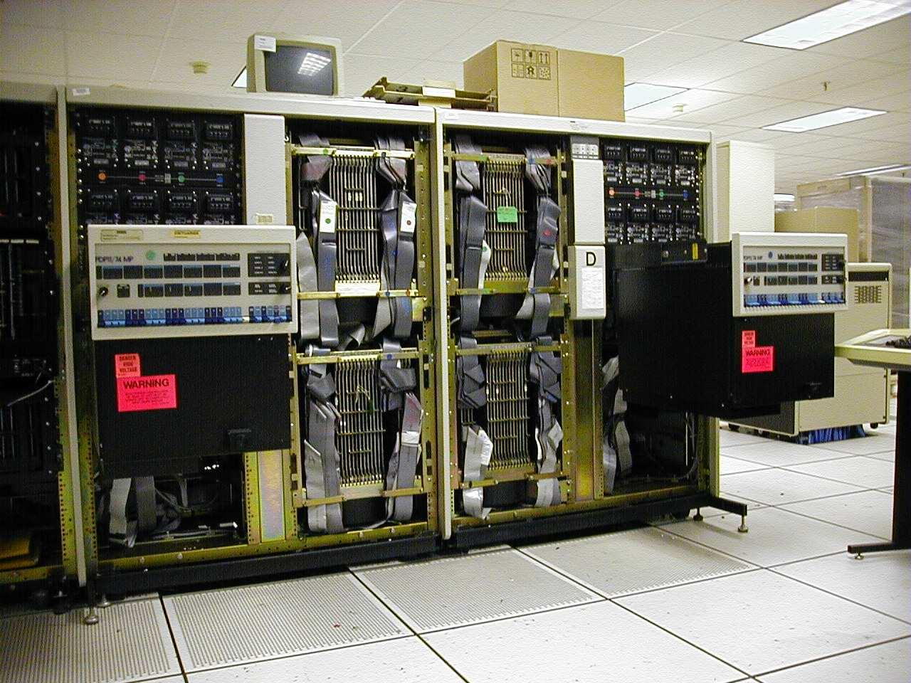
Mainframe
Notes:
One « computer » is composed of multiple huge racks, everything is interconnected and as close as possible
=> Dedicated to manage numerous I/O simultaneously

Slide 53
Mainframe Operating System
z/OS (IBM), zLinux (IBM), z/VM (IBM), GCOS (Bull/Atos)
IBM machine: z15
z/OS (formerly known as MVS)
Look’n feel of the OS/360, but with latest upgrades (POSIX compatible)
zLinux
Linux working on a giant machine
Atos/Bull machine : BullSequana M Series
GCOS 7 & 8

Slide 54
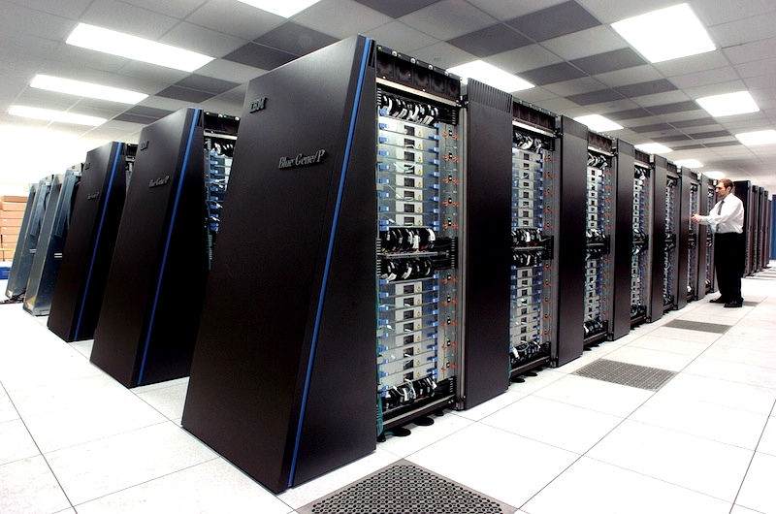
Specific case: Supercomputers
Notes:
Here, we can see all the racks full of servers (probably 2U) linked together

Slide 55
Specific case: Supercomputers / HPC
Not really « one » computer like a mainframe
Well, back in time, it was « one » computer (Cray, …)
Combination of a lot of small servers (« nodes »)
Each will make calculus
Dedicated to calculate
Code a program, launch it, wait a long time for the result…
…like « calculators » and mainframes in 1st and 2nd generations
Currently runs specific OS
Dedicated Linux for HPC (RHCS) and/or softwares (slurm)
Notes:
Supercomputers = « super calculateurs » or « super ordinateurs »
HPC = High Performance Computing
Usage: « science »… and initially nuclear weapons simulations (instead of doing it in real life), but also biology (folding proteins, DNA, …)

Slide 56
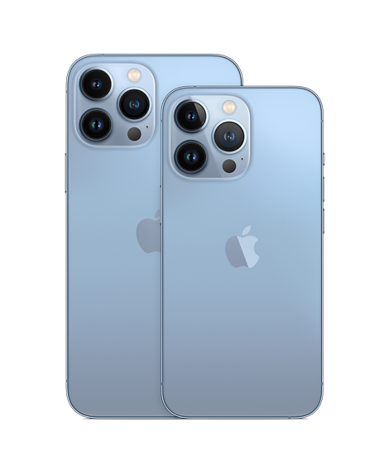
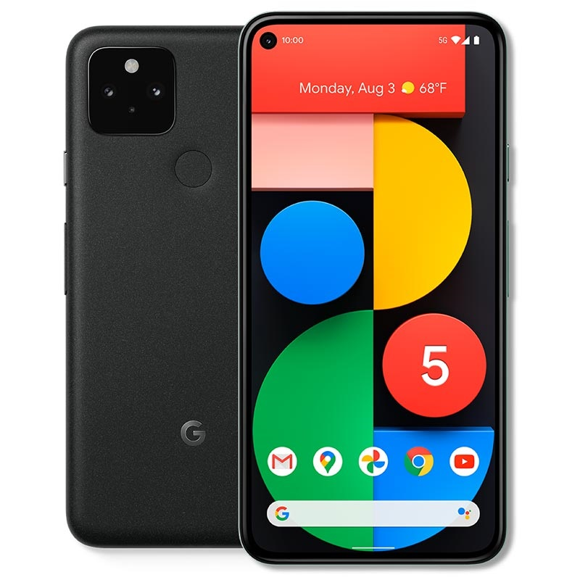
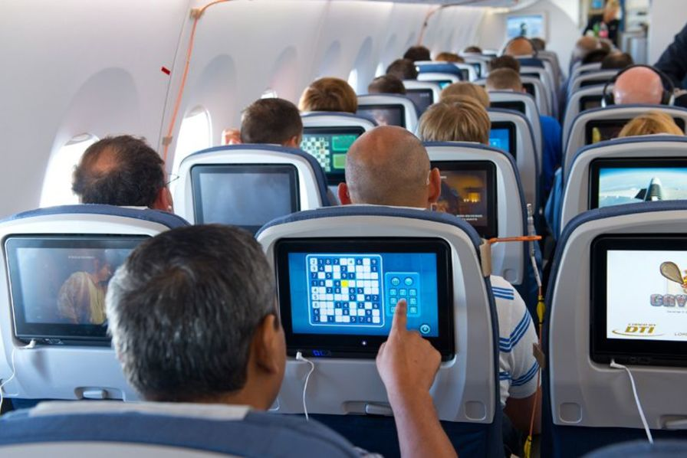
Specific case: Embedded Systems / Mobile & IoT
(Very) Small factors (IoT, Raspberry pi, …)
Mobile (Tablets, GPS, …) and smartphones
Android
iOS
Windows: Windows IoT, Windows Embedded family (WinCE, …)

Slide 57
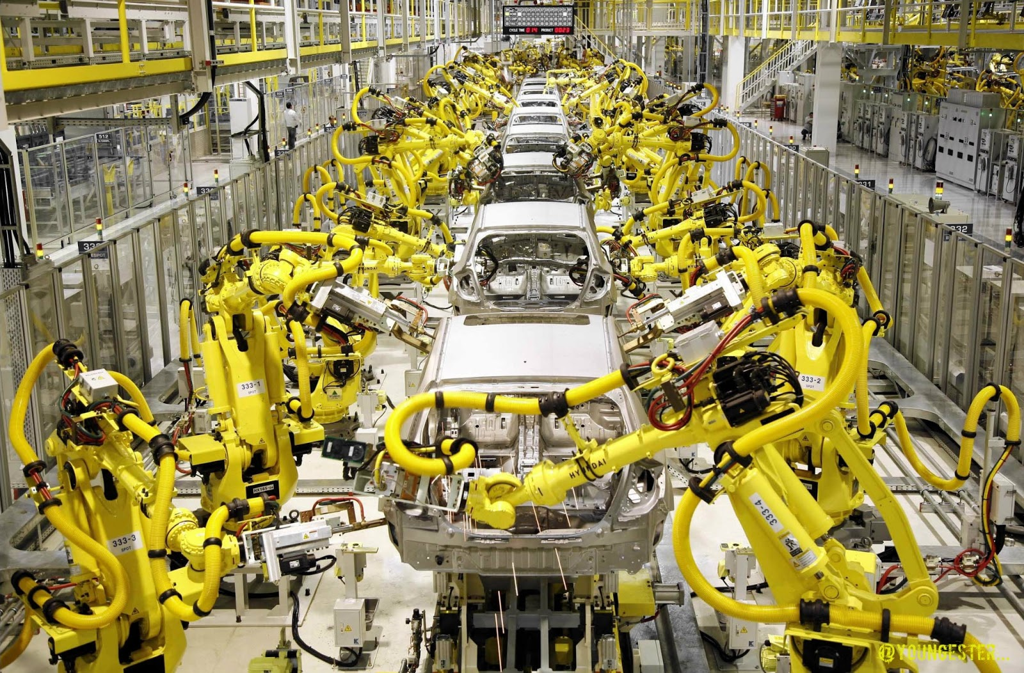
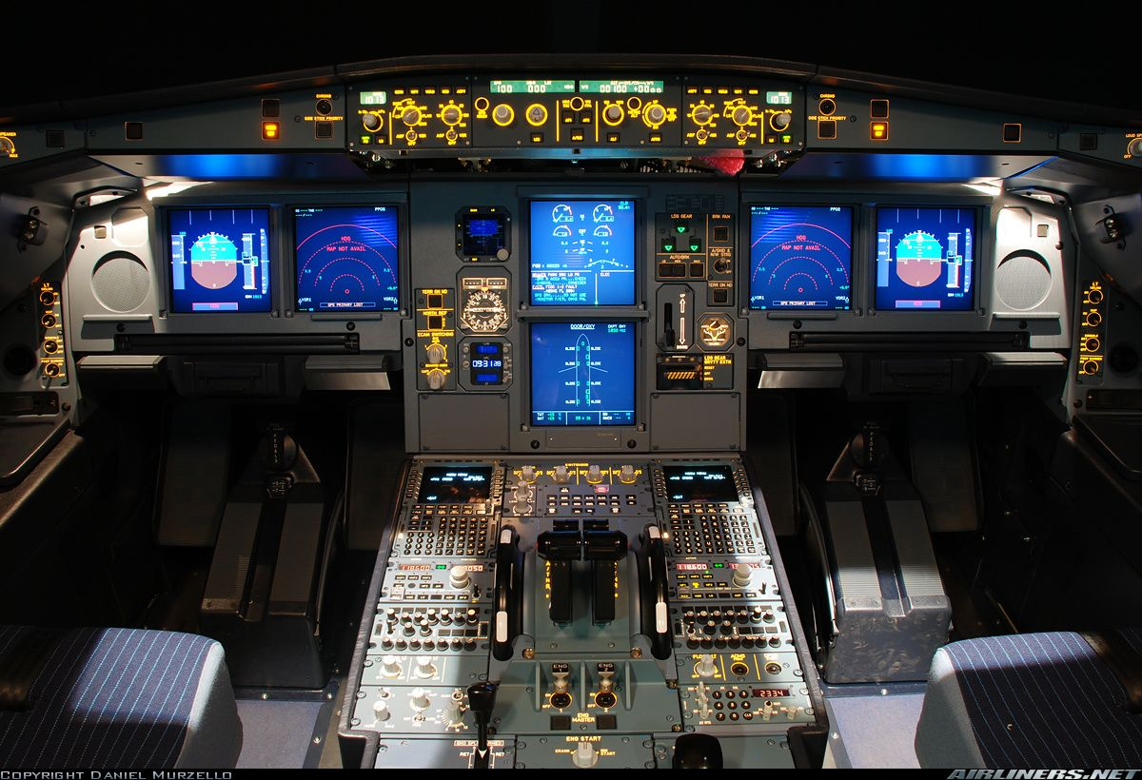
Specific case: Real-Time
Notes:
Assembly lines/Industrial Automation, Aicraft systems/Avionics, Healthcare, … : read probes and controls valves, motors, servo motors, line speed, …

Slide 58
Specific case: Real-Time
Computer system directly linked to mechanical system
Usually environment with constraints, and/or human life involved
Dedicated processor: DSP (Digital Signal Processor)
DSP controls signal (tension, current, …) instead of only bits/bytes
Specific OS for industry and real-time
Must comply with very strict certification (formal verification, …)
Eventually, Linux in real time

Slide 59
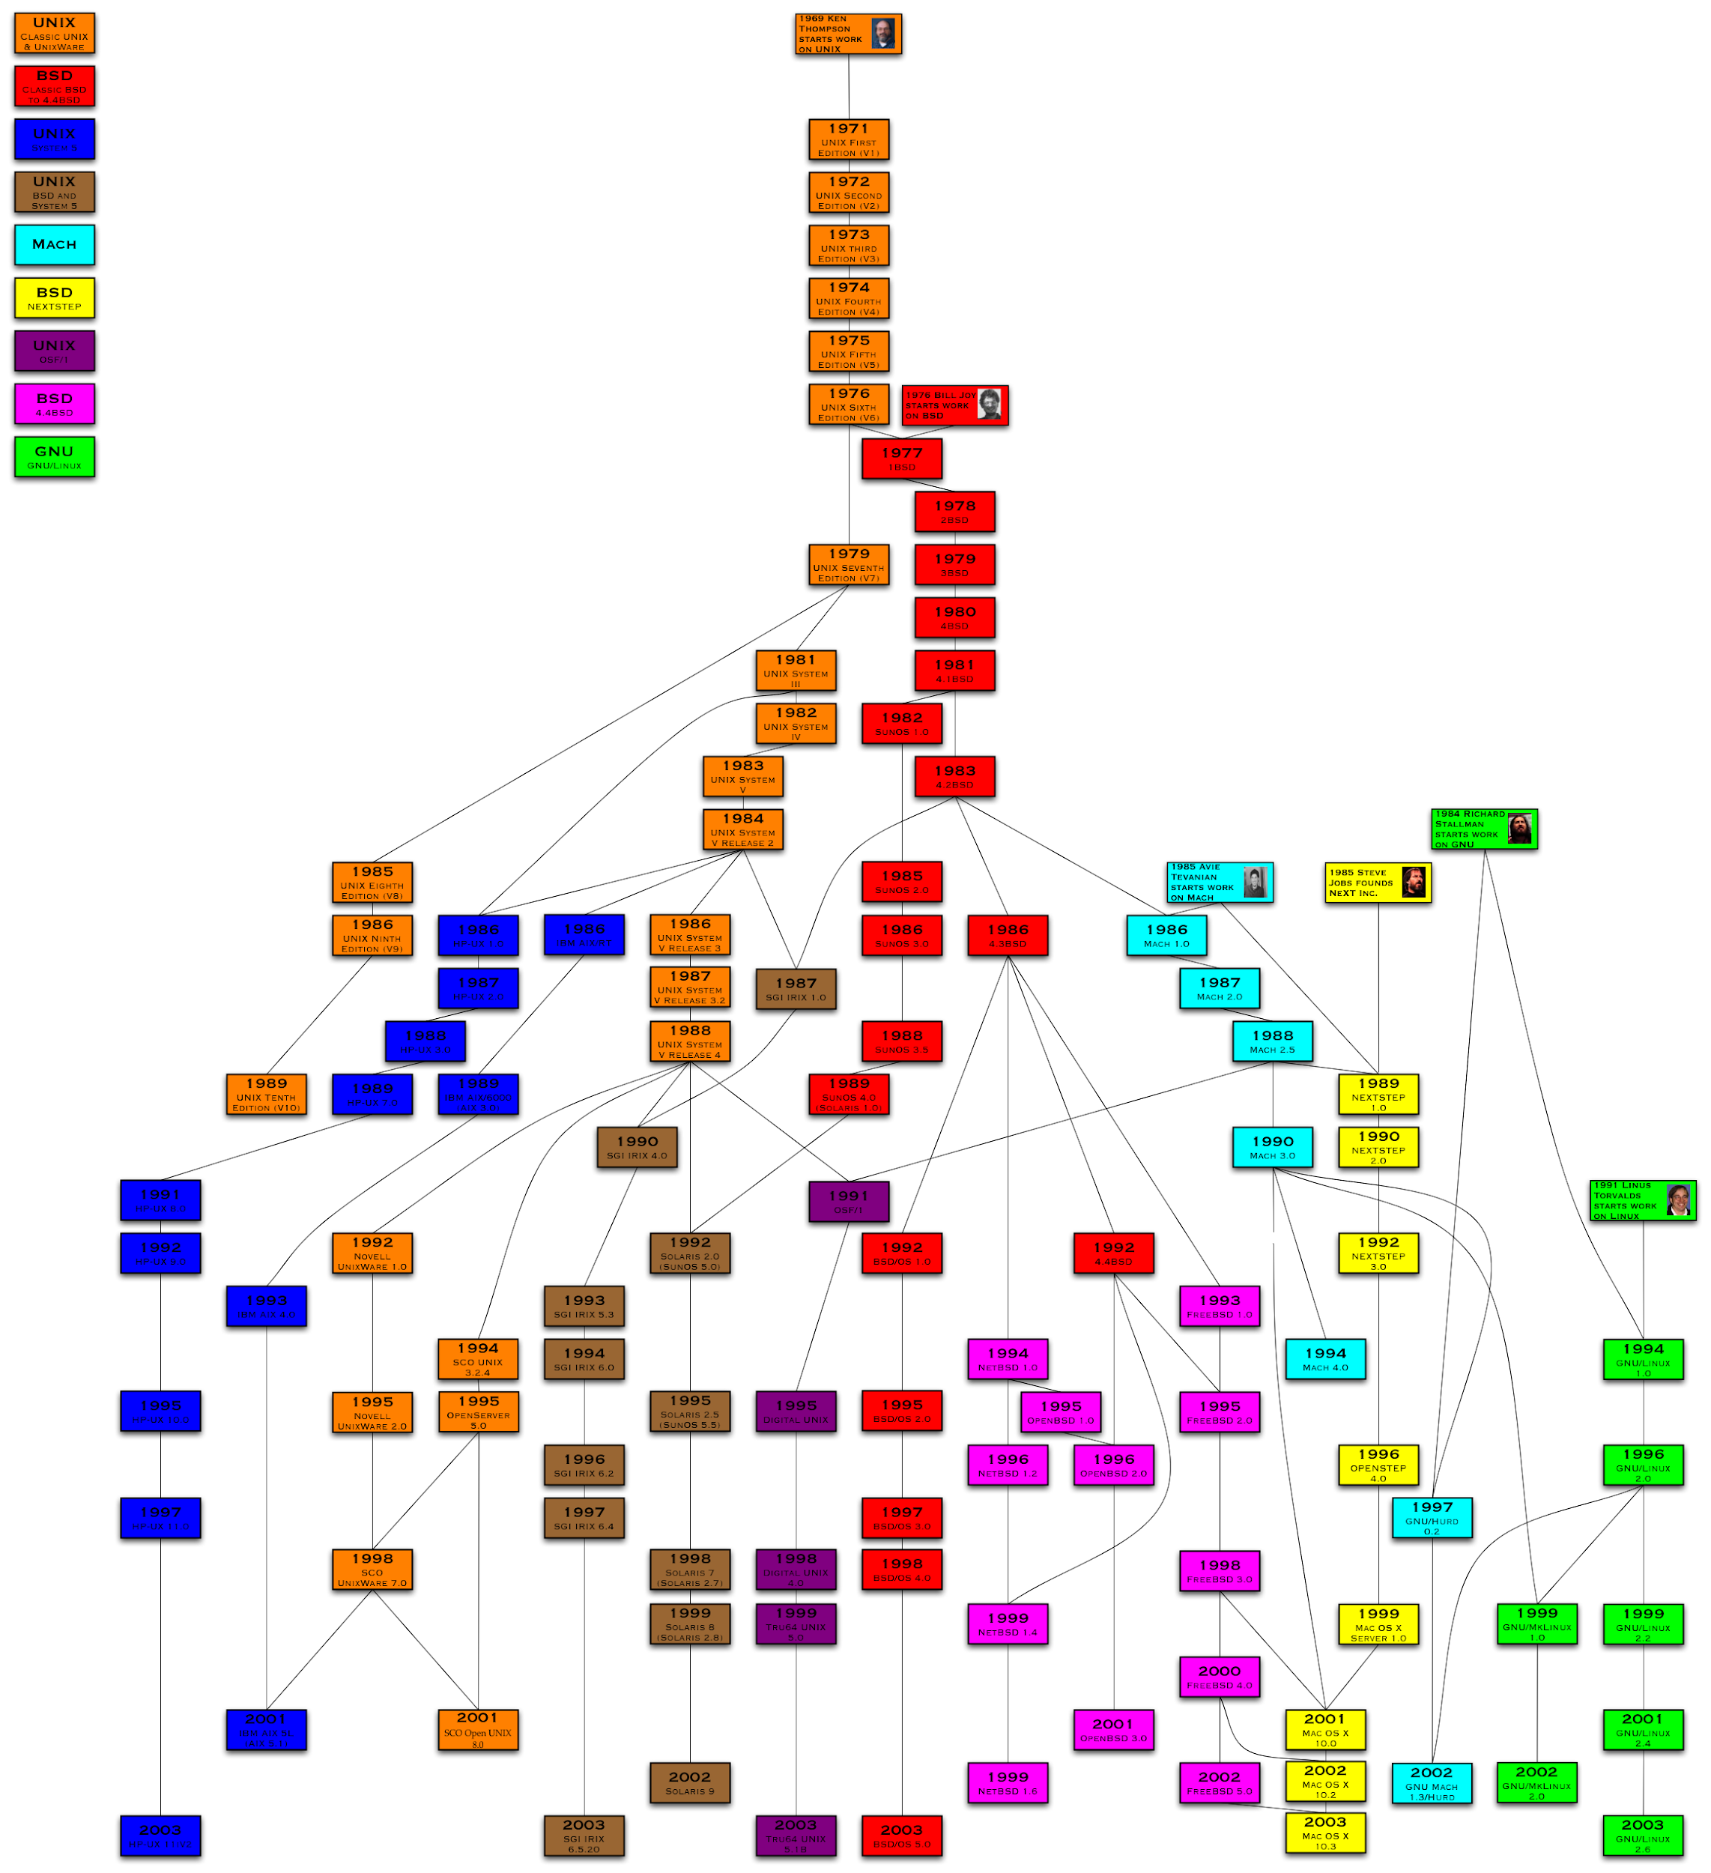
UNIX
[Core of this course]
Big manufacturers wrote their own UNIX for their own CPU architecture
…compatibility?
Rather…

Slide 60
Unixes Jungle
1969 – 1979 : Unix 1-6
“SVR4” stands for “System V Release 4”
1978 : BSD
1992 : FreeBSD, 4.4 BSD, NetBSD
1994 : OpenBSD
1987 : NextStep
2001 : Mac OS X
1987 : Minix
1991 : Linux

Slide 61
UNIX / POSIX
POSIX (Portable Operating System Interface)
UNIX was the perfect candidate
Family of standards for maintining compatibility between OS
Functionalities, Functions and Syscalls, Commands, Libraries, …
Not every UNIX & Linux is completely POSIX
Non-UNIX OS can be POSIX compliant (or at least partially)
Windows (WSL, POSIX subsystem, …)
z/OS (USS/UNIX System Services)

Slide 62
Standardization & Portability
POSIX helps to maintain a standard layer and common mechanisms
Programs are « easier » to port on various OS
(well « easier » may not be so easy…)
Applications
Portable applications
Operating System
Specific applications
(dedicated to hardware)
Hardware

Slide 63
What is inside an OS?

Slide 64
Inside the OS
Kernel: basic functionalities, syscalls
Services: Accounts (login, nsswitch), Display Service
Libraries: support functions, APIs (libc, libm, OpenGL)
Applications: Web browser, Text Editor, Shell
Support Applications: Terminal Emulator

Slide 65
What is a kernel?
Software that runs in privileged mode
“Heart” of the system
Critical part (no error allowed inside)
Delivers the first abstractions
Hardware independence
Basic resources management
This is a jungle too

Slide 66
Some Glossary
User: an account
Root: the (most) privileged account
Shell: a command interpreter (that launches programs)
System call: a function provided by the kernel

Slide 67
Some Glossary
Kernel mode/Kernel land: privileged mode
User mode/User land: unprivileged mode
System Call/Syscall:
Functionally: Allows a program to ask a service to the kernel
Technically: Mechanism for switching from user land to kernel land
Might be a software interruption…
…or a specific instruction (SYSENTER/SYSEXIT, SYSCALL/SYSRET, …)

Slide 68
Main concepts
USERLAND
GUI
multimedia players
spreadsheet editor
malloc
games
libc
text editor
mail
web browser
shell
SYSCALLS
open
fork
socket
wait
read
KERNEL
…
…
write
pipe
Device management
File System management
dup2
ioctl
Process management
…
Memory management
…
…

Slide 69
Main concepts
Everything not in kernel, is in userland
USERLAND
GUI
multimedia players
spreadsheet editor
malloc
games
libc
text editor
mail
web browser
shell
SYSCALLS
open
fork
socket
wait
read
KERNEL
…
…
write
pipe
Device management
File System management
dup2
ioctl
Process management
…
Memory management
…
…

Slide 70
Main concepts
An OS includes a kernel, libraries, and utilities
(some graphics, some CLI only)
USERLAND
GUI
OS
multimedia players
spreadsheet editor
malloc
games
libc
text editor
mail
web browser
shell
SYSCALLS
open
fork
socket
wait
read
KERNEL
…
…
write
pipe
Device management
File System management
dup2
ioctl
Process management
…
Memory management
…
…

Slide 71
Kernel design: multiple models
Monolithic kernel
Every kernel service is running in kernel mode (drivers, FS, …)
One giant abstraction exposed to applications
Microkernel
Minimum kernel services run in kernel mode (scheduling, memory, IPC)
Kernel works like a broker: applications and services send/receive messages
Hybrid/Modular kernel
Some services are in userland, some are in kerneland
Fewer message passing (less kernel/user switching that take time)
Extreme cases: Nanokernel, Exokernel, Unikernel
Fewest code as possible, kernel as a library with each program, …
Notes:
There is multiple kind of designs for kernels. At some point there was some kind of flame war going on about which way is better. Read the documents about it, it is quite interesting.
linus vs tanenbaum

Slide 72
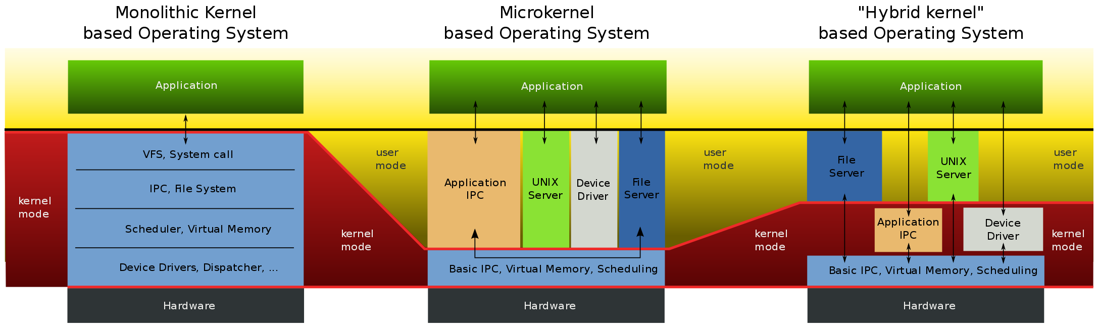
Kernel design: multiple models

Slide 73
Main concepts
Reminder:
The OS exposes an abstraction of the machine
User
OS
Machine
Usable Interface
Resource Management
Hardware Independence

Slide 74
UNIX & Linux

Slide 75
UNIX
Family of operating systems
2 branches: System V (SVR), BSD
SUS (Single UNIX Specification), POSIX
Delivers the first abstractions
Hardware independence
Basic resources management
“Everything is a file”

Slide 76
Linux
UNIX re-written from scratch
One kernel (sometimes modified): www.kernel.org
GNU re-written softwares (glibc, gls, gawk, …)
Distributions
Group of preinstalled softwares for dedicated usages Kali Linux for pentest, Debian for servers, Ubuntu for client, …
Some might be sold with technical support and patches Red Hat, SUSE, …
Mainly POSIX-compliant
Don’t worry: the common UNIX things are all here…

Slide 77
UNIX/Linux: do not fear terminals
CLI: Command Line Interface
Type everything in a terminal (directly sends characters)
Call programs by their names, and add parameters
Perfect for precise configuration and automation
GUI: Graphical User Interface (since 80s~90s)
Graphical environment with buttons
Call programs with buttons and clicks
Simplified for business users, but heavier to run and manage However: precise configuration might be available in a file

Slide 78
UNIX/Linux: do not fear terminals
CLI: Command Line Interface
Windows: MS-DOS (BATCH language), PowerShell, WSL (Windows Subsystem for Linux)
UNIX/Linux: shell (sh, csh & tcsh, bash, ksh/Korn-shell, zsh, …)
GUI: Graphical User Interface
Windows: explorer.exe
UNIX/Linux: X server (X11, Xorg, …) + window manager (dwm, xfce, Gnome, KDE, …)

